Slide 1
Title VOICE BASED EMAIL FOR VISUALLY IMPAIRED
Submitted by,
K.Chinna Maruthu -952519104301
T.Johns -952519104302
P.Karthick -952519104303
K.Vijayalakshmi - 952519104012
M.Kartheeswari -952519106302

Slide 2
SCOPE
For people who can see, e-mailing is not a big deal, but for people who are not blessed with gift of vision it postures a key concern because of its intersection with many vocational responsibilities.
As a future scope voice could be extended to image attachments and other options such as indentation, fonts etc., that are available with normal E-Mail.

Slide 3
OBJECTIVE
This project aims at developing an email system that will help even a naive, visually impaired person to use the services for communication without previous training.
The system does not require the use of keyboard and mouse.
Instead it will work only on speech conversion to text.

Slide 4
ABSTRACT
Now-a-days internet has become one of the basic aids for day-to-day living. Every human being is widely accessing the knowledge, information and also using for communication through internet.
However, blind people face difficulties in accessing these net-based information, also in using any service provided through internet. The advancement in computer based accessible systems has opened up many possibilities for the visually impaired across the worlds in a wide way.
Audio based virtual environment like, the screen readers and many voice-based search engines have helped Blind people to access internet applications immensely. We describe the Voice-based mail system architecture that can be used by a Blind person to access e-Mails easily and efficiently. The contribution made by this research has enabled the Blind people to send and receive voice-based e-Mail messages with the help of a computer

Slide 5
DOMAIN INTRODUCTION

Slide 6
PYTHON
Python is a widely used general-purpose, high level programming language.
It was created by Guido van Rossum in1991 and further developed by the Python Software Foundation.
It was designed with an emphasis on code readability, and its syntax allows programmers to express their concepts in fewer lines of code.

Slide 7
SYSTEM REQUIREMENTS
Software Requirements:
Python IDLE
Google Speech-to-text and text-to-speech Converters.
Hardware Requirements:
Windows Desktop

Slide 8
EXCITING SYSTEM
Simple e-mail systems are available in which only voice recognition & text-to-speech systems are accessible by remembering the keyboard shortcuts to access.
The existing voice-based e-mail system has made use of IVR, Speech to text converter, Mouse click event and Screen reader.
There will be a small icon of mic on who’s clicking the user had to speak and his/her speech will be converted to text format, which the blind people would see and read also, as in references

Slide 9
DISADVANTAGE
User have to use mouse connected to the computer and should perform mouse click events to send and receive emails.
In existing system, they have chosen Web UI as the interface for system which is not easy for the impaired people to use

Slide 10
PROPOSED SYSTEM
Because using this technology involves visual perception, it is extremely difficult for visually impaired persons to use it.
This is because in order to access the internet you would need to know what is written on the screen, which is not possible by blind person.
In this proposed system it mainly concentrates on four different types of technologies Speech-to-Text (STT) this module collects the speech given by the user and converts to Text, Text-to-Speech (TTS) this converts the response give to system to Speech, Chatbot for making the conversation more sense and for giving responses more like a human and finally, mail communication module for sending and receiving emails.

Slide 11
ADVANTAGES
Doesn’t need any mouse click events to send and receive emails.
Purely based on the voice commands given by the user.
Chatbot is used to make the conversation smooth and more like a human response.

Slide 12
SYSTEM ARCHITECTURE
USER
LOGIN
INBOX
CHECKBOX
COMPOSE MAIL
TEXT-TO-SPEECH
SPEECH-TO-TEXT
EXIT

Slide 13
MODULES
User:
User is one who uses the application and make use of it.
Voice recognition:
Voice recognition is the ability of a machine or program to receive and interpret dictation or to understand and carry out spoken commands.
Text to speech:
There are several APIs available to convert text to speech in Python. One of such APIs is the Google Text to Speech API commonly known as the gTTS API. gTTS is a very easy to use tool which converts the text entered, into audio which can be saved as a mp3 file.
Speech to text:
This is done with the help of Google Speech Recognition. This requires an active internet connection to work. . Google Speech Recognition is one of the easiest to use.

Slide 14
SENDING EMAIL
User has to give the input in the form of voice note.
User wants to speak what he wants to do.
For sending the Email the user has to say ”SEND” and the system will respond the “You have chosen to send an Email”.
At next it will ask to speak the body of the Email.
The user wants to speak the body of the mail what he wants to send and the system will replay what the user have been said and it sends the Email.

Slide 15
READING EMAIL
For reading the Email the user wants to choose the read option through voice note.
Next the system respond accordingly and ask the user for the serial number of the Email to be read.
When the user give the input for that it says that from which Mail ID it has been sent and start reading the email along with its subject.

Slide 16
EXIT EMAIL
For exiting form the mail the user wants to give the input as “EXIT” on voice note.
The system replay as that ‘You have chosen to exit”.
And it will exit the application.

Slide 17
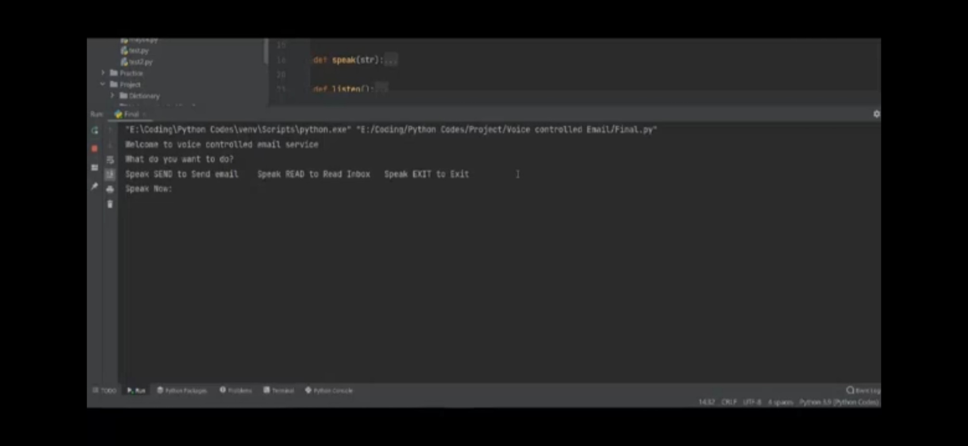
RESULT
At first step the system ask the user what to do ,whether the user wants to SEND the Email or READ the email or to EXIT.

Slide 18
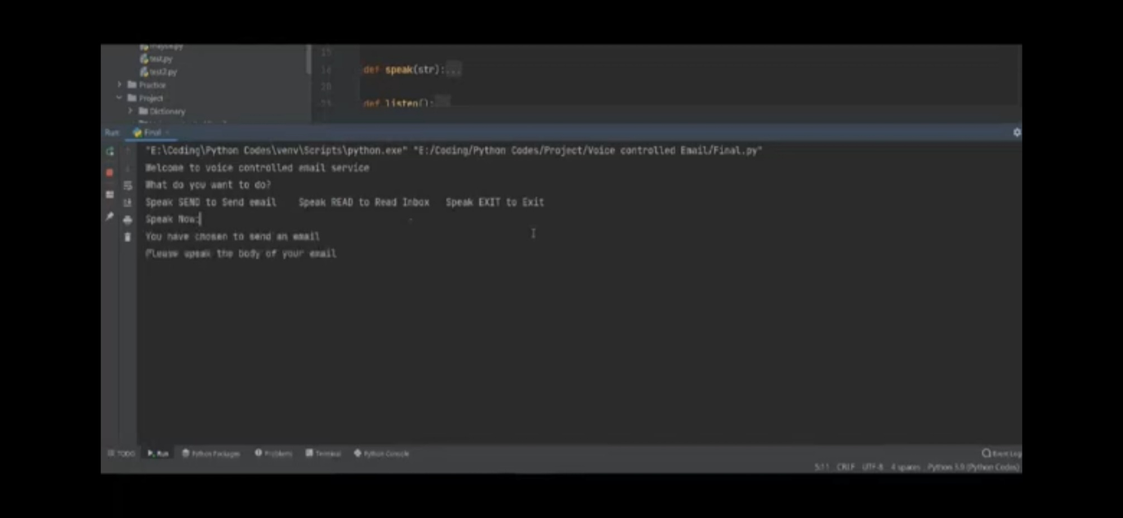
When the user choose to SEND the Email the system ask the user to speak the body of the Mail.

Slide 19
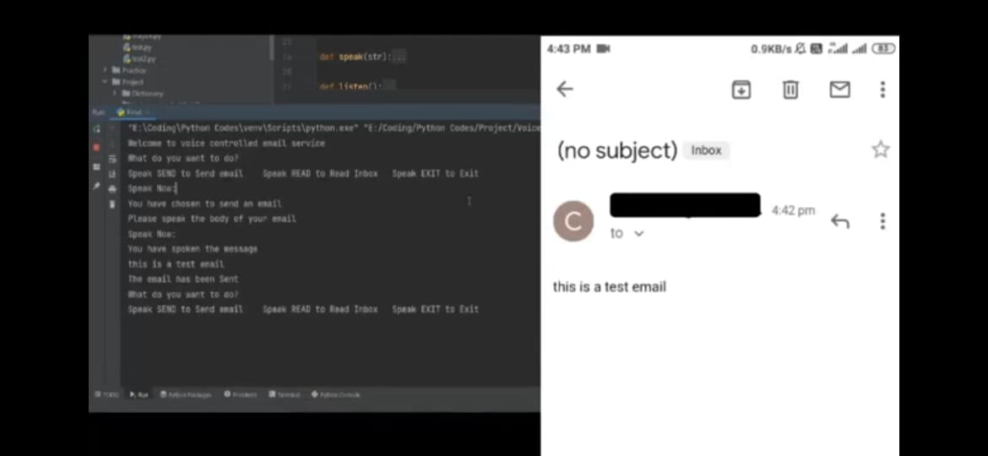
After that the system conforms the body of the mail what the user have said and it sends the Email.

Slide 20
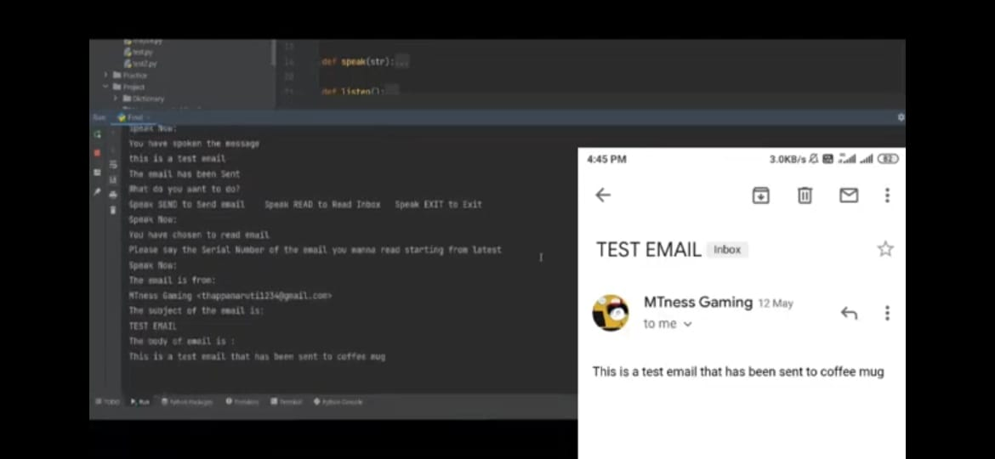
At next the system ask again what to do , if we choose to READ the Email it ask the serial number and it reads the body of the mail and from which mail id it has been send.

Slide 21
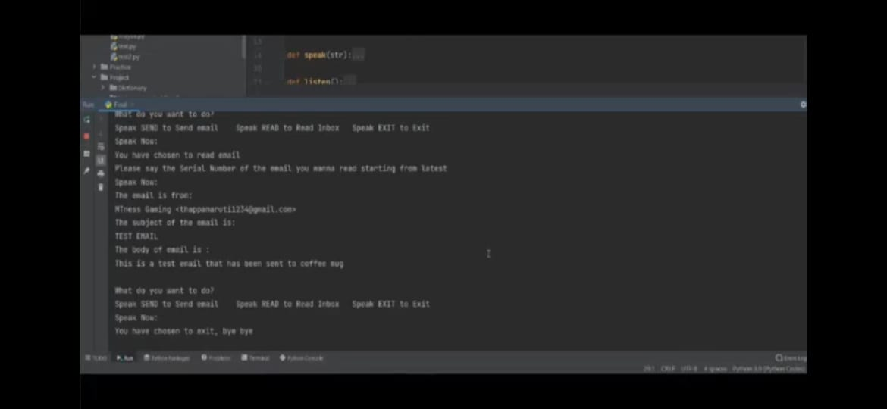
Atlast if the user chooses to EXIT it will exit the application.

Slide 22
CONCLUSION
The main objective of the project is to establish email communication based on voice commands for blind people because of their inability to use internet and its functions.
We achieved in receiving unseen mails giving senders mail id, subject, message in the form of voice as output.
We achieved building text to speech, speech to text modules and also implemented a chatbot from effective communication between the user and the system, it can not only establish email communication but can also answer the questions asked by the user.
We created a registration module for ease of access to user and also providing security and privacy up to some extent

Slide 23
FUTURE ENHANCEMENT
This application can be easily used by the users of any age group.
The system has implemented Google Speech-to-Text and Text-to-Speech APIs. This makes the system convenient for use by visually impaired people.
The people having typing problems can also take advantage of this system.

Slide 24
REFERENCE
[1] Parkhi Bhardwaj, Gunjan Sethi “Voice Based E-mail System for Visually Impaired: A Review” published in International Research Journal of Engineering and Technology (IRJET) on December 12th, 2020.
[2] John Klensin; Ned Freed; Marshall T. Rose; Einar A. Stefferud; Dave Crocker (November 1995). SMTP Service Extensions. IETF. doi:10.17487/RFC1869. RFC 1869.
[3] K. Jayachandran, P. Anbunami: “Voice Based Email for Blind People” published in International Journal of Engineering and Technology in 2018.

Slide 25
[4] Carmel Mary Belinda, Rupavathy.N, Mahalakshmi N R: “Voice based e-mail System for Visually Impaired” published in International Journal of Engineering and Technology in 2018.
[5] Mamatha, A., Jade, V., Saravana, J., Purshotham, A., & Suhas, A. V. (2020): “Voice Based E-mail System for Visually Impaired” published in International Journal of Research in Engineering, Science and Management.
[6] Belekar A, Sunka S, Bhawar N, & Bagade S: “Voice Based E-mail for The Visually Impaired” published in International Journal of Computer Applications

Slide 26


